Slide 1
Hello Suraj
Hi everyone

Slide 2
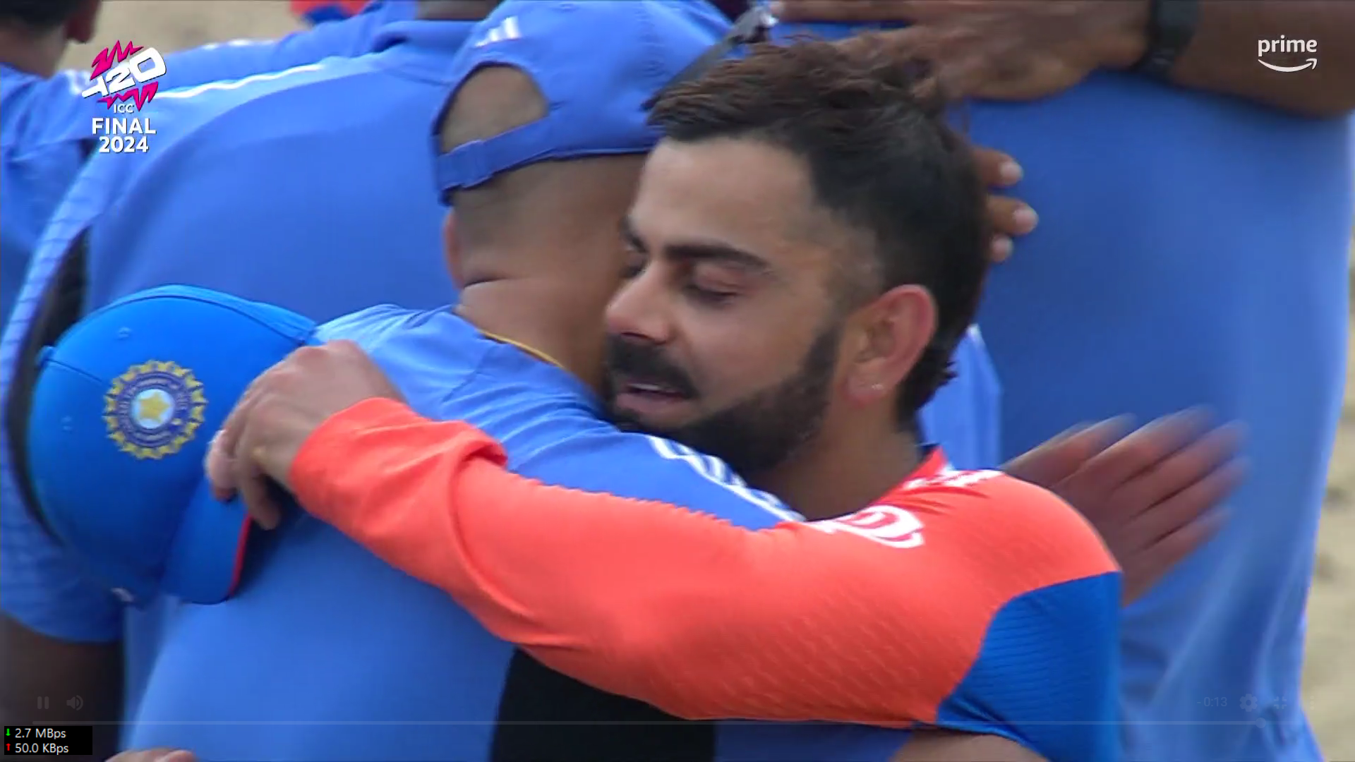
INDIA

Slide 3
Thank You

